Slide 1
Design patterns

Slide 2
Agenda
Singleton (GoF)
Factories
Simple factory
Factory method (GoF)
Abstract factory (GoF)
Templates
Template method (GoF)
Template with callback

Slide 3
Singleton

Slide 4
Singleton
Only one class instance is needed in the entire application.
E.g. Hibernate’s SessionFactory
Global point of access to the object.

Slide 5
Example: GUI

Slide 6
Factories

Slide 7
Factory
In OOP, a factory is an object used for creating other objects by invoking one of its methods.
Typically used when object creation is too complex for a constructor.
Makes polymorphism during object creation possible.
Implementation variants:
Simple factory
Factory method
Abstract factory

Slide 8
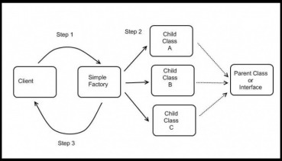
Simple factory
Creates objects without exposing the instantiation logic to the client.
Refers to the newly created object through a common interface.

Slide 9
Example: GUI

Slide 10
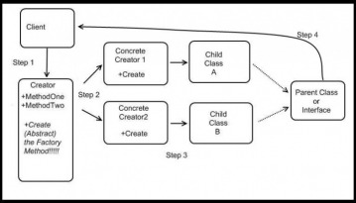
Factory method
Defines an interface for creating objects, but lets subclasses decide with class to instantiate.
Refers to the newly created object through a common interface.

Slide 11
Example: GUI

Slide 12
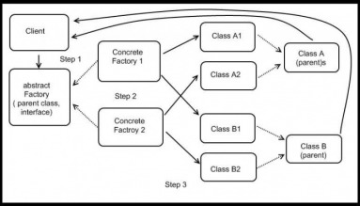
Abstract factory
Interface for creating a family of related objects, without explicitly specifying their classes.

Slide 13
Example: GUI

Slide 14
Templates

Slide 15
Template method
Identifies the framework of an algorithm, allowing implementing classes to define the actual behavior.
Common behavior among subclasses should be localized to a common (base) class.

Slide 16
Example: PizzaShop

Slide 17
Template with callback
A concrete template class rather than a base class implements the framework and invokes callback objects that provide the actual behavior.
Inheritance can be used for something else.

Slide 18
Example: PizzaShop

Slide 19
Exercises

Slide 20
Exercise: Library
Modify the Library application:
Support the JDBC and Hibernate family of DAOs using factories.
Eliminate the boilerplate code in the DAOs using templates.

Slide 21
Application: AliExpress
Modify the AliExpress application:
Support the in-memory, JDBC, and Hibernate family of DAOs using factories.
Eliminate the boilerplate code in the DAOs using templates.

